Slide 1
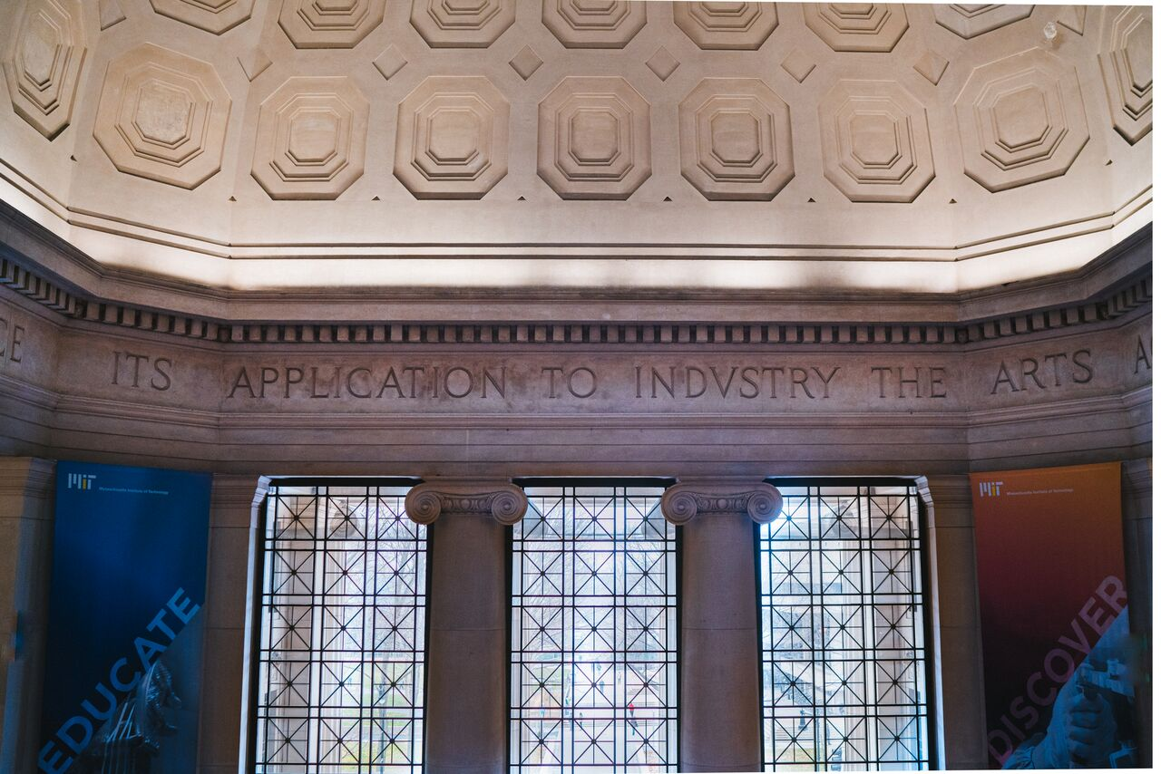
Telling the MIT (engineering) story
Message & Channel Recommendations
Prepared with Blue State Digital
© Blue State Digital | Proprietary and Confidential
Notes:
AMELIA
Key audiences weren’t hearing why MIT is special
Started by investigating what makes MIT and its approach to engineering distinct… to communicate that to people who matter most to you
------
Earlier this year, Ian came to us with a problem: key audiences weren’t hearing why MIT is special (and it was starting to show in numbers like recruitment of undergrad cross-admits to Stanford.)
To tackle this challenge, we started by investigating what makes MIT and its approach to engineering distinct, in order to better communicate those differences to the people who matter to you.

Slide 2
Our charge by Dean Waitz & his Dean’s Advisory Council (Fall 2016)
Attract top talent, at all levels
Undergraduate students
Incoming MIT students are getting “better” and yield at a record high
Peer competition (HYPS) continuing to increase, esp. Stanford
Graduate students
Stanford remains our top competitor across all DLCs
MIT EECS vs Stanford is concerning (as are DMSE, IDSS, and BE)
Faculty
We anticipate ongoing fights for the best people (hiring & retention)
Industry is ever more attractive
Notes:
AMELIA
We started out by talking to key stakeholders including:
DLC and SoE communicators
MIT News staff
MIT Admissions staff, including Stu Schmill
And Institute leaders like Cindy Barnhart and Dennis (“Denny”) Freeman
We also talked to audience members spanning:
Undergraduate students (who also served as proxies for prospective students)
Graduate students
And alumni
We came up with a set of differentiators for what sets MIT apart from its peers—and how to talk about MIT engineering in a way that feels distinct from competitors. By speaking in a consistent voice, we can ensure that our audiences are getting the right messages, no matter who is crafting the story.
When the DAC last convened, they specifically recommended…
Delving deeper into the cross compete data and responding to what we found AND…
Enhancing communications & marketing
Continuing to innovate in education
THINKING BIG
Since then Nate Nickerson has called for a “marketing revolution at MIT” (we are all a part of that)

Slide 3
Our response to date
Internal
Expanded the SoE communications team: strategy and media relations, writer, multimedia
Integrating efforts across DLCs, coordinating centrally (in process)
External
Blue State Digital phase 1: strategy
Blue State Digital phase 2: messaging and channel audit (complete)
Context: $ remains a factor for all key stakeholders
MIT: Campaign for a Better World
SoE: core needs (fellowships, endowed chairs)
Top two competitors also fundraising aggressively
Enhancing the brand, increasing engagement
Notes:
AMELIA
We started out by talking to key stakeholders including:
DLC and SoE communicators
MIT News staff
MIT Admissions staff, including Stu Schmill
And Institute leaders like Cindy Barnhart and Dennis (“Denny”) Freeman
We also talked to audience members spanning:
Undergraduate students (who also served as proxies for prospective students)
Graduate students
And alumni
We came up with a set of differentiators for what sets MIT apart from its peers—and how to talk about MIT engineering in a way that feels distinct from competitors. By speaking in a consistent voice, we can ensure that our audiences are getting the right messages, no matter who is crafting the story.
When the DAC last convened, they specifically recommended…
Delving deeper into the cross compete data and responding to what we found AND…
Enhancing communications & marketing
Continuing to innovate in education
THINKING BIG
Since then Nate Nickerson has called for a “marketing revolution at MIT” (we are all a part of that)

Slide 4
Our response to date
Supporting Institute level efforts
Understanding our reputation/audiences
VP for Comms just completed a global reputational survey
Exploration committee on improving the visitor experience
Working with admissions to enhance marketing efforts
Facilitating connections
Corporations, local businesses (beyond just ILP/TLO)
Improving alumni + friends communications
Working with MIT AA on efforts to better coordinate alumni outreach and engagement

Slide 5
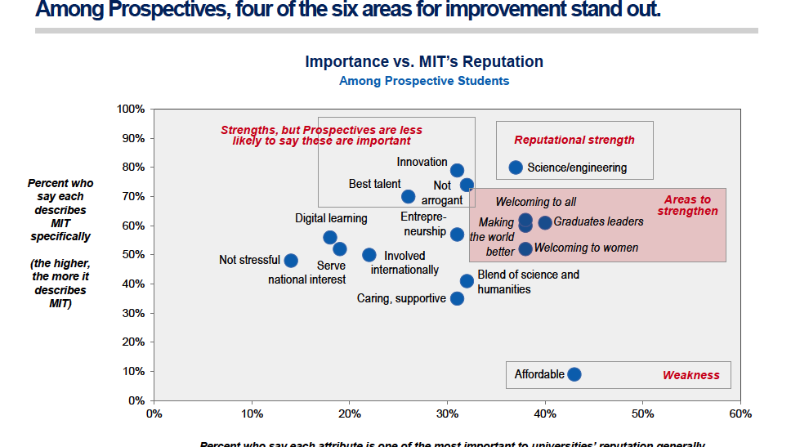
Driven by surveys and data
I want to convey that while we are following the charge of the DAC … a lot of this work is all driven by data and surveys .. And here’s just one example from the reputational survey.
And no, this graphic doesn’t need to be clear ... It’s just a reference point.
Notes:
AMELIA
We started out by talking to key stakeholders including:
DLC and SoE communicators
MIT News staff
MIT Admissions staff, including Stu Schmill
And Institute leaders like Cindy Barnhart and Dennis (“Denny”) Freeman
We also talked to audience members spanning:
Undergraduate students (who also served as proxies for prospective students)
Graduate students
And alumni
We came up with a set of differentiators for what sets MIT apart from its peers—and how to talk about MIT engineering in a way that feels distinct from competitors. By speaking in a consistent voice, we can ensure that our audiences are getting the right messages, no matter who is crafting the story.

Slide 6
The work to date
Phase 1: Research & Plan
Stakeholder interviews
Audience interviews
Competitor review
Messaging strategy
Notes:
AMELIA
We started out by talking to key stakeholders including:
DLC and SoE communicators
MIT News staff
MIT Admissions staff, including Stu Schmill
And Institute leaders like Cindy Barnhart and Dennis (“Denny”) Freeman
We also talked to audience members spanning:
Undergraduate students (who also served as proxies for prospective students)
Graduate students
And alumni
We came up with a set of differentiators for what sets MIT apart from its peers—and how to talk about MIT engineering in a way that feels distinct from competitors. By speaking in a consistent voice, we can ensure that our audiences are getting the right messages, no matter who is crafting the story.

Slide 7
Differentiators
Differentiating Messages
MITers are like-minded, but not alike.
MITers turn off their “no” switch.
If the faculty disappeared, MIT students would continue working.
MIT is an Idea Collider.
MITers loves challenges—the harder, the better.
1
2
3
4
5
Notes:
“MITers turn off their “no” switch”
“3 miracles”
Optimism
Willingness to fail
Embracing the unknown
“MITers are like-minded, but not alike”
Relief of being around likeminded people
Similar in how they’re different
No egos
Wake up 3am…
“MITers are a little bit off”
“A Hadron Collider for Ideas”
We’re on top of each other
Student-Faculty face time
Collaboration between SoE and SoS
“If faculty disappeared, the students would continue working”
Learning for learning’s sake
Grit/tenacity/Chutzpah
Substance over style
Honest day’s work/ “Fish tastes better…”
Obsessiveness
MITers go to the nth degree
“MITers don’t explore new fields, we create them”
Digging deep, not dropping out
Leaps, not baby steps
Transformative, not trendy
Start ups that don’t stop/keeping going
The people who brought you everything you take for granted
Substance over style
Not about getting rich quicker
Media Lab
“Hands on learning”
Learn by doing
Fail fast, move on
Mens et Manus
Fresh doing research (UROPs)

Slide 8
The work to date
Phase 1: Research & Plan
Stakeholder interviews
Audience interviews
Competitor review
Messaging strategy
Phase 2: Create & Develop
Stakeholder and staff alignment
Staff survey
Channel audit
Creative recommendations
School & DLC comms strategy
Notes:
AMELIA
The work before us now—and the work we’ve been engaged in for the last few months—is identifying where to bring those distinctly MIT messages to life, and how.
We started by sharing the findings of Phase 1 with your communicators—after we last met with you—and by surveying them about their daily activities as communicators and the channels they run.
We also dug into the channels and metrics themselves to better understand what’s working and what’s not, where our audiences are gravitating to.
We distilled these findings into a set of creative and strategic recommendations for how to get the MIT Engineering messages out there—hitting the right audiences with the right messages on the right channels. That’s the work we’ll be reviewing with you today.

Slide 9
The work to come…
Phase 1: Research & Plan
Stakeholder interviews
Audience interviews
Competitor review
Messaging strategy
Phase 2: Create & Develop
Stakeholder and staff alignment
Staff survey
Channel audit
Creative recommendations
School & DLC comms strategy
Phase 3: Implement
Channel updates
Staff trainings
Creative implementation
Measurement & tracking Ongoing optimization
Notes:
AMELIA
Next up is the heavy lifting of bringing this all to life. We’ve already started to equip Ian, Chad, and Michael with tools to regularly track KPIs, and at the end of our presentation today, we’ll open it up to you to tell us how you can see operationalizing these recommendations in your own departments.
So what did we learn?

Slide 10
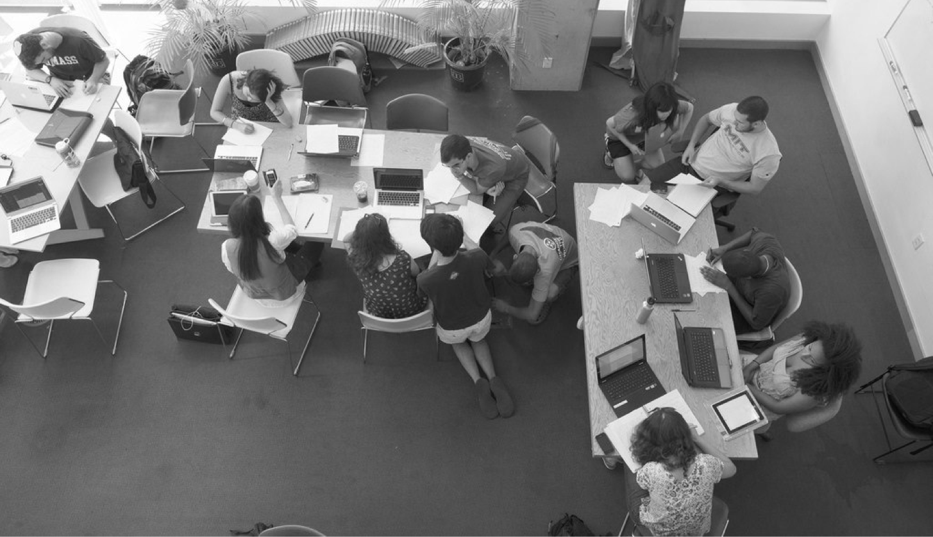
The Audit
Notes:
CHAPTER SLIDE: NO VOICEOVER

Slide 11
We started with the data, evaluating website, email, and social performance.
Notes:
CHAD
WE STARTED WITH DATA...
WEBSITES
Uniques and pageviews
Most popular pages
Average pages per session
Bounce rate
Traffic sources
User demographics (i.e., traffic from within Cambridge vs. outside)
SOCIAL
Total page likes (Facebook) and followers (Twitter)
Monthly new likes (Facebook) and followers (Twitter)
Number of posts
And engagement metrics
Facebook Engaged Users: total number of users who have clicked on a post (including likes, comments, and shares)
Twitter Engagements: sum of all actions taken on any post (including retweets, replies, likes and media plays).
EMAIL
Data from iModules only (many send thru their own ESPs)
Asked alumni to forward us mails
It’s a lot!

Slide 12
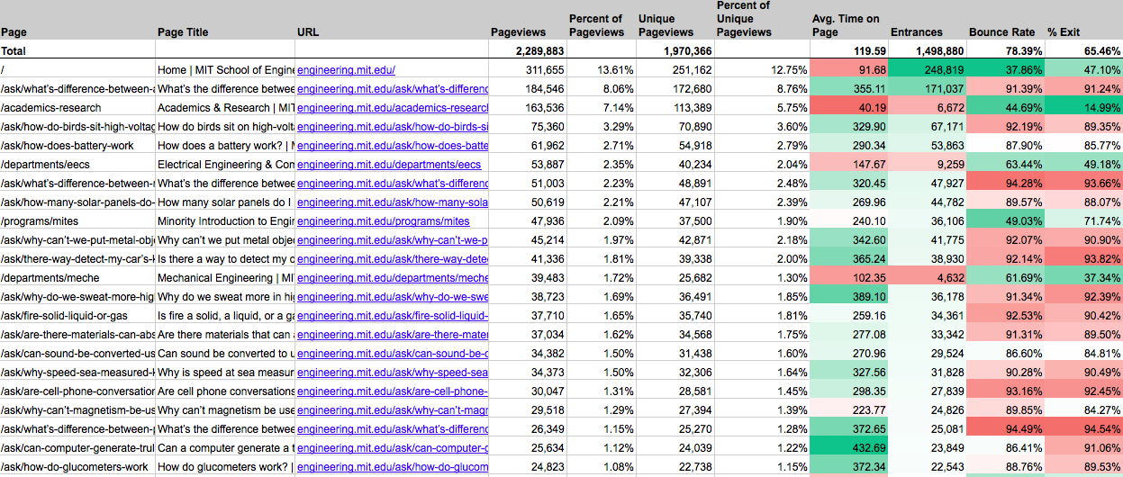
We looked at our top website pages.
Notes:
[IAN (here or earlier): And you’ll have access to the run-down of those metrics after today.]

Slide 13
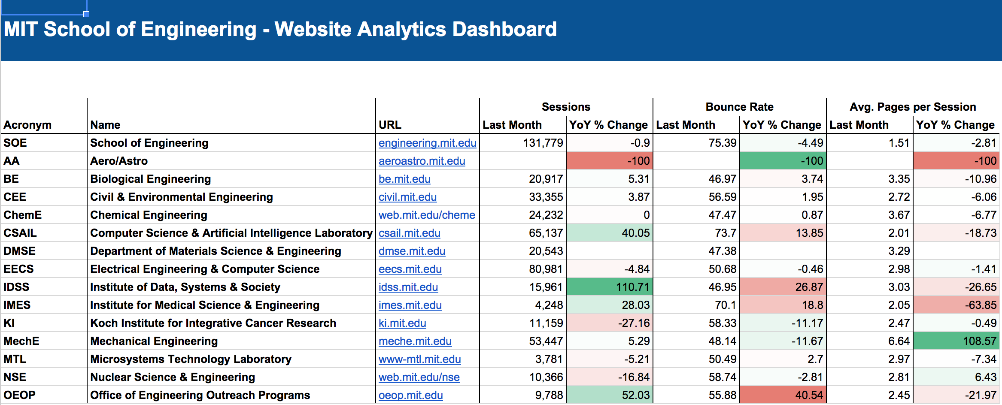
We compiled them into a single report.
Notes:
[IAN (here or earlier): And you’ll have access to the run-down of those metrics after today.]

Slide 14
We looked a bit deeper…
Sessions in August
Notes:
CHAD
Here’s a simplified view of WEBSITE data.
Biggest departments got about HALF OF THE TRAFFIC of SoE.

Slide 15
We did the same thing for social.
Notes:
[IAN (here or earlier): And you’ll have access to the run-down of those metrics after today.]

Slide 16
Facebook likes (as of June 30)
As of June 30, 2016
Notes:
CHAD
Here’s a simplified view of WEBSITE data.
Biggest departments got about HALF OF THE TRAFFIC of SoE.

Slide 17
Twitter followers (as of June 30)
As of June 30, 2016
Notes:
CHAD
Here’s a simplified view of WEBSITE data.
Biggest departments got about HALF OF THE TRAFFIC of SoE.

Slide 18
We then took one step back…
Twitter followers as of June 30, 2016
Notes:
CHAD
Here’s a simplified view of WEBSITE data.
Biggest departments got about HALF OF THE TRAFFIC of SoE.

Slide 19
Then checked again…
Twitter followers of October 5, 2016
Notes:
CHAD
Here’s a simplified view of WEBSITE data.
Biggest departments got about HALF OF THE TRAFFIC of SoE.

Slide 20
And we looked back at ourselves too…
43,000 as of today
I want to add this as SoE does / can play a convening role … and another big channel for getting stories out ... We have more than just the NO!
As of June 30, 2016
Notes:
CHAD
Here’s a simplified view of WEBSITE data.
Biggest departments got about HALF OF THE TRAFFIC of SoE.

Slide 21
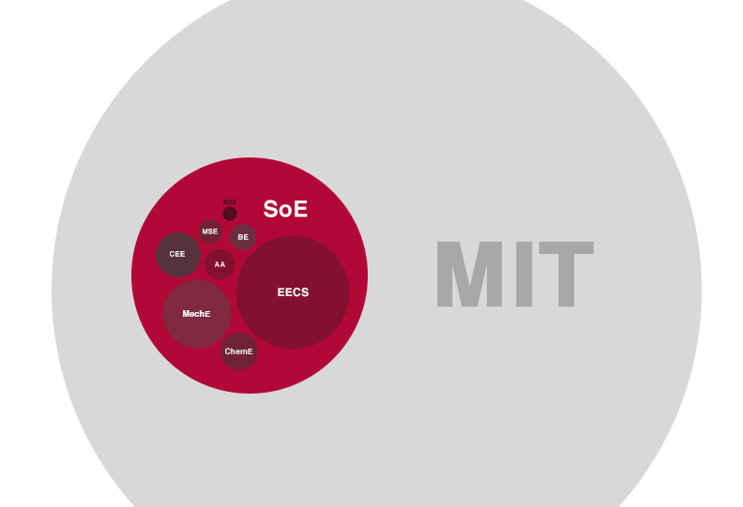
Notes:
CHAD
The goal here is pretty obvious. REACH!
SoE and MIT as amplifiers.
Ultimately, it’s about giving your most important stories the lift to better reach the audiences that matter most to you, and to the School.

Slide 22
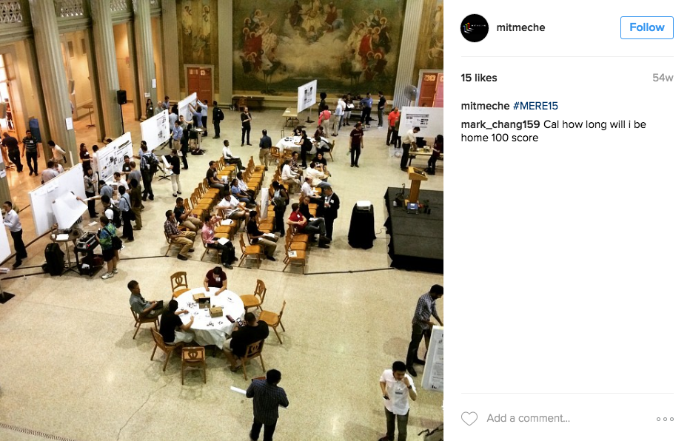
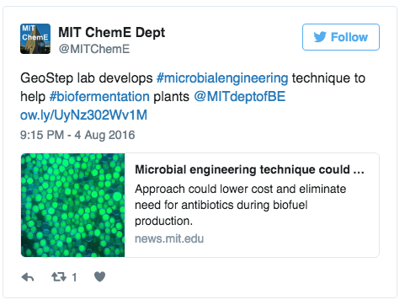
Considerable, uncoordinated effort is yielding limited returns.
Notes:
CHAD
Spending a lot of time creating content that wasn’t getting consumed.
This extended, in many cases, to social: Few followers, minimal interactions

Slide 23
And while analytics is not everything…
Tweeting to no one is a lonely business.
Print is tough to measure.
Notes:
CHAD
It’s expensive. Designing, printing, mailing
It’s hard to measure its impact. Received? Took an action? Email provides a lot more info, even how far down the page they scrolled, when they lost interest and bounced.
It’s not shareable. Versus a click!
It’s not optimizable. Email and websites can be A/B tested, and updated in realtime.
You can’t customize it. Emails targeted by major, geographical location, expressed interests, and previous behavior.

Slide 24
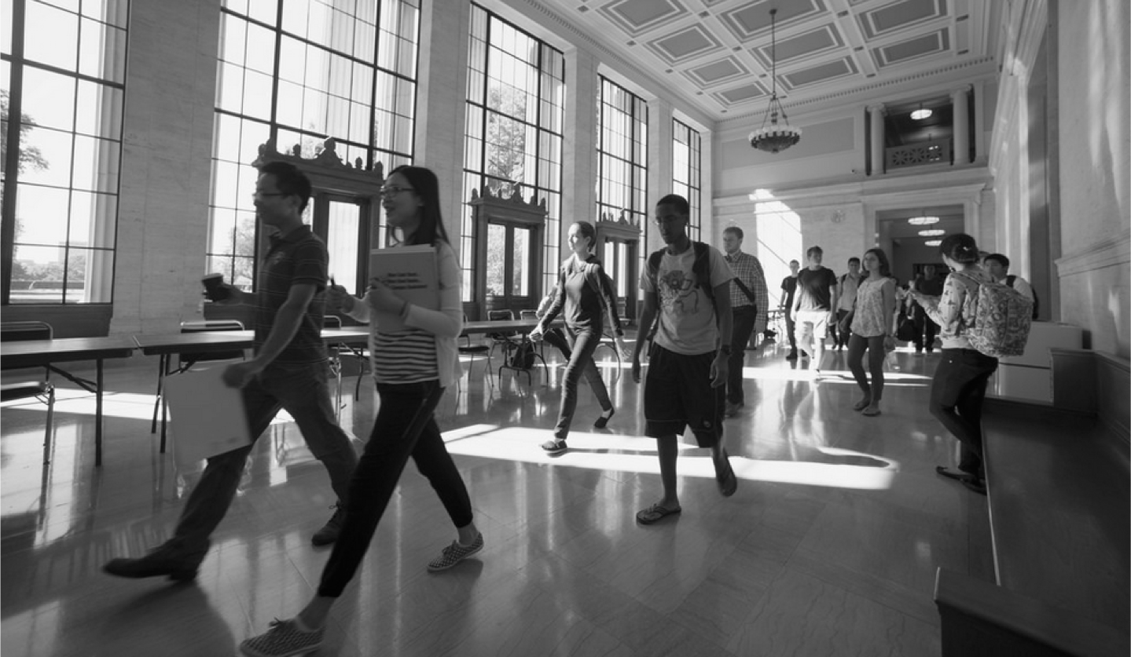
Message Strategy

Slide 25
Inform
Inspire
Notes:
CHAD
When we looked at your content, it fell into two buckets:
Undergraduates (and prospective undergraduates) are more concerned about lifestyle, making sure they get the full “college experience.”
Prospective graduate students and faculty aren’t as concerned with that—they’re undergrad days are behind them. They’re focused on extracting information, vetting and researching specifics of the tools and resources they’ll have at their fingertips by coming to MIT.
So what do these audiences find when they visit current sites?

Slide 26
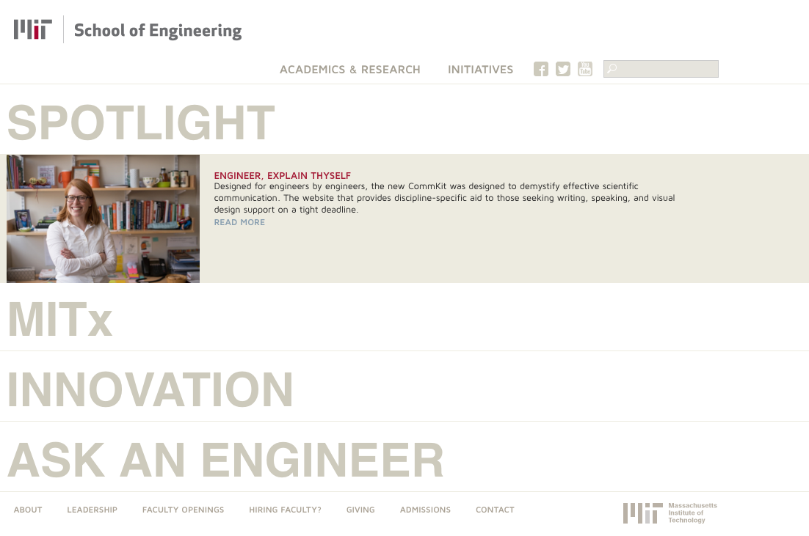
Notes:
CHAD
The current SoE site is a vacuum: There’s no “there” there. It’s a blank slate, a pass-through to DLC sites, so undergrads seeking inspiration are pointed to sites that don’t address their needs. In short, there’s a big hole SoE should be filling.

Slide 27
Notes:
CHAD
Meanwhile, the DLCs have done their best, finding their own approaches. There are two ends of the spectrum:
MechE: Cool and accessible (Popular Science), but distracting and even irrelevant if you’re a grad student.
MechE is filling the SoE gap by doing a great job at storytelling and inspiration...but to the wrong audience.

Slide 28
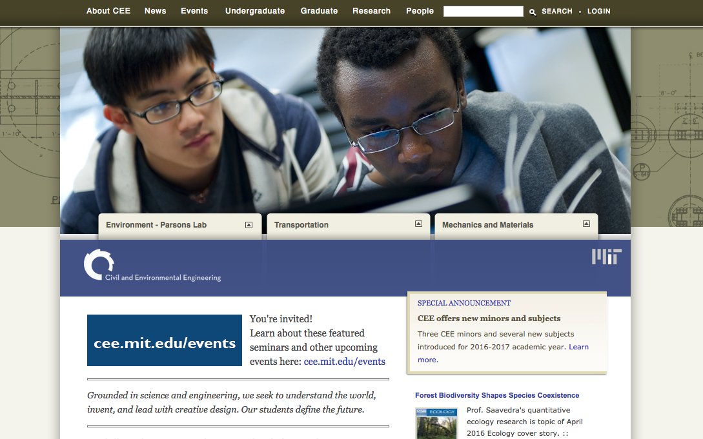
FULL CEE SCREENSHOT
Notes:
CHAD
Meanwhile, there’s CEE, whose site is more functional and utilitarian. It’s about providing clear links to info, resources.
Such different approaches!
When we asked DLC communicators, “Who are you creating content for?” their responses were, almost universally, “everybody” and “alumni.”

Slide 29
Civil & Environmental Engineering
Mechanical Engineering
People (Faculty) | 25.7% of total traffic
Homepage | 23.3%
Education (Academics) | 20.4%
Research | 18.9%
News & Media | 3.4%
Graduate Academics | 20.0% of total traffic
Research | 11.7%
Homepage | 9.2%
Faculty | 7.7%
Undergrad Academics | 6.0%
Notes:
CHAD
So we followed the traffic.
The traffic tells a different story of who’s coming to these sites and what they’re looking for.
Across the board, the three most popular types of content on ALL DLCs were Faculty, Research, and Academics.
NEWS cracked the top 5 for MechE...but it only makes up 3.4% of total traffic.

Slide 30
On most DLC sites, news content accounts for less than 5% of traffic.
Notes:
CHAD
In fact, the highest NEWS got was 5%, but for most DLCs it was closer to 2%.
Lots of effort being spent creating content for the WRONG PEOPLE at the WRONG TIME and WRONG PLACE.

Slide 31
Inform
Statistics
Research
Utility
Specific
Academics
Committed
What it takes to study here
Inspire
Stories
Browsing
Understanding
General
Lifestyle
Curious
What it’s like to study here
Notes:
CHAD
DLCs have inspirational content, but it languishes in their current channels.
Give it more life through SoE
You’re the experts! DLC communicators play a more active role in HELPING CRAFT THE OVERALL NARRATIVE of engineering at MIT through stronger COLLABORATION with the Dean’s office communicators.

Slide 32
DLCs
Prioritize informative content.
Elevate inspirational content to the MIT level.
MIT
Focus on differentiators.
Amplify DLCs’ best stories.
Notes:
CHAD
What does this look like in practice?
WE want to prioritize informative content on DLCs
Use SoE and MIT to amplify our best INSPIRATIONAL content.

Slide 33
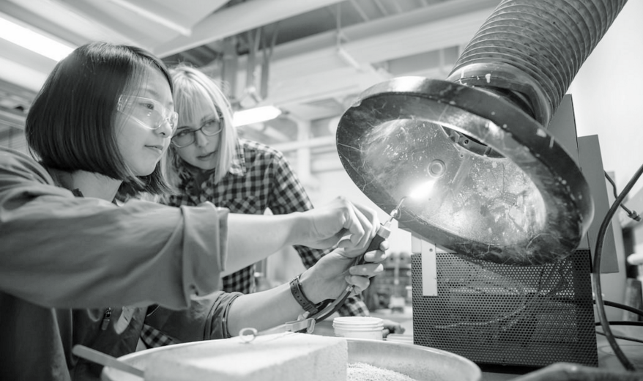
What’s next

Slide 34
The Need
To maximize its recruitment efforts, the School of Engineering (SoE) must close the gap between what prospective students and faculty have heard about MIT and the reality of the MIT experience.

Slide 35
How we’ll get there
Establish an SoE messaging strategy that conveys the MIT Duality and differentiators.
Clarify the roles and responsibilities of communicators at the SoE and Department/Lab/Center (DLC) levels — in relation to each other as well as MIT News, the Alumni Association, and other Institute communicators.
Refocus DLC communicators on content types and channels with the most impact, and eliminate those that distract.
Set up an editorial workflow that promotes transparency, reduces duplication of efforts, and increases the reach of DLCs’ best content.
Create a “to-do” list for each department, and set deadlines for implementing these recommendations.
Identify SoE- and DLC-specific KPIs to measure success.
Establish a shared language around engineering as problem solving, while at the same time allowing DLCs to express their unique personalities within that framework.

Slide 36
Tone & Voice
All communications featuring engineering should adhere to these narrative principles.
Smart
MIT Engineering is intelligent and loves challenges.
Let’s respect the high achievements and aspirations of our audiences by speaking to them as equals. We should assume they could be at MIT.
Academic, as if speaking to your brightest colleague
Sophisticated but not exclusive
Self-assured but not arrogant
Quirky
MIT Engineering embraces the inner nerd, and that creativity enriches the work.
MIT has its own brand of fun and celebrates the eccentric. Let our audiences experience the weird, wonderful “magic moments” visitors have on campus.
Imaginative but not cloying
Unpredictable and unexpected, but always constructive
Obsessed and proud of that obsession
Practical
MIT Engineering values hard work and, at the end of the day, results.
In some way or another, every story from MIT is about changing the world. Let’s broadcast that problem-solving mentality.
Down-to-earth, in-the-trenches
Meritocratic and results-oriented
Optimistic that our work changes the world for the better

Slide 37
Tone & Voice
The tone and voice should match the speaker, content, and channel.
DLC
Site
Clear and concise
Utilitarian; to the point
Specific to department and discipline
Social
Passionate
Nerdy about subject matter
Insidery
Technical
MIT
Site
Detail-rich and descriptive
Aspirational
Future-focused
Social
Passionate
Colorful
Fun, but not off-puttingly nerdy
Expert

Slide 38
Inspiration Seekers
These users visit the SoE’s channels looking for content to expand their understanding and feel a connection with the Institute. They tend to be motivated by emotions. Details about research and lists of faculty publications won’t cut it; the best way to reach these users is through compelling storytelling that puts a human face on MIT and low-barrier content that shows the impact of the innovations that happen here.
Information Seekers
Other users are unmoved by emotional appeals and are looking for hard data. They’re not here to browse; they’re on a mission to find information to complete tasks (book lab space, apply) and extract information (course requirements, faculty contact info). They skip stories of student life and dig into content that is probably too complex for more casual audiences.
Inspiration
Stories
Browsing
Facebook Live
Understanding
Browsing
General
Lifestyle
Curious
What it’s like to study here
Information
Statistics
Research
IRL conversations
Utility
Researching
Specific
Academics
Committed
What it takes to study here
* Remember, these are fluid groups. Inspiration-seekers often have tasks to complete; and information-seekers are not immune to a good story that reminds them why MIT is special.

Slide 39
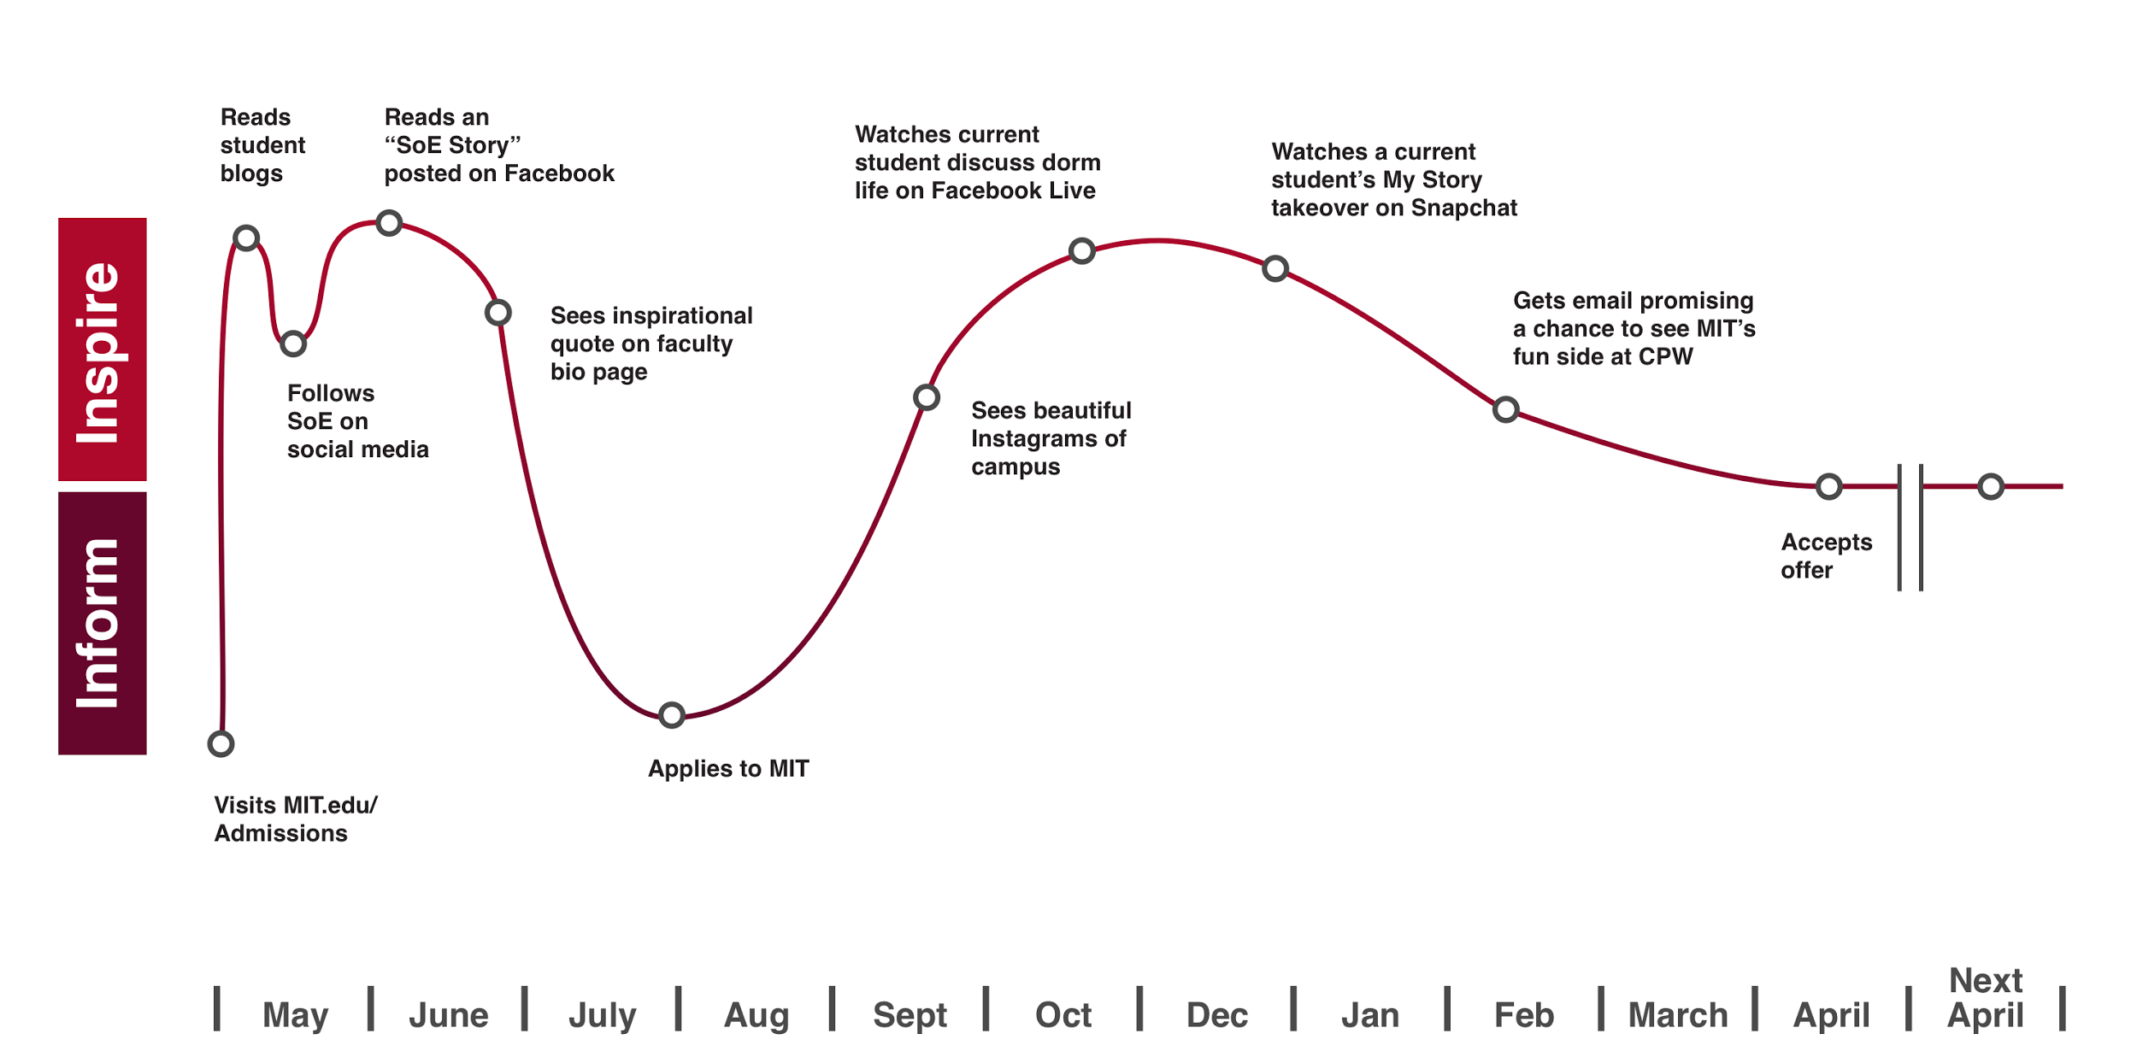
Prospective undergraduate student
Major selection
Notes:
LAURA
The point of these slides is that while prospective undergrads are mostly about INSPIRATION, and Prospective grads/faculty are more about INFORMATION, they will seek both at some time.

Slide 40
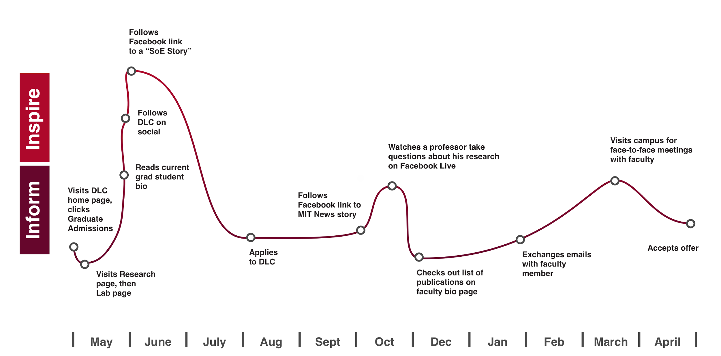
Prospective graduate student
Notes:
LAURA

Slide 41
DLCs
Graduate students and faculty
MIT
Prospective undergraduates
(Of course it’s not quite this simple…)
Notes:
CHAD
What does this look like in practice?
WE want to prioritize informative content on DLCs
Use SoE and MIT to amplify our best INSPIRATIONAL content.

Slide 42
Matching Audiences to Channels
Over the years, DLCs have expanded into multiple platforms, in many cases without a clear strategy or unique value proposition to offer audiences. This proliferation of channels has resulted in audience attention being scattered across multiple accounts, none of which tells the whole story of engineering at MIT. The net result—from a user’s perspective—is a fragmented, confusing, uneven representation of engineering at MIT.
We recommend that, with the exception of Facebook, DLCs’ social media accounts be retired and rolled into a single SoE-level account. DLC audiences on most of these platforms are too small and unengaged to justify the time spent maintaining them. SoE social accounts should be operated by communicators charged with curating a mix of content from all DLCs that inspires and informs, depending on the nature of the social platform.
Integration at the school level will allow DLCs to spend more time optimizing their communications work to provide the most utility to their information-seeking audiences.
MIT/SoE
Website
Facebook
Twitter
Email
YouTube
Instagram
DLCs
Site
Facebook
Email
Notes:
Message to the dean: 30 communications people with a bullion channels. It’s time to focus and deliver better. Narrow.

Slide 43
Notes:
CHAD
The goal here is pretty obvious. REACH!
SoE and MIT as amplifiers.
Ultimately, it’s about giving your most important stories the lift to better reach the audiences that matter most to you, and to the School.

Slide 44
What’s missing?
Clarity of purpose
Data
Measurability
Coordination

Slide 45
What’s changing?
Clarity of purpose: Starting here (we hope), but still in the works…
Data: Also starting here, but real KPIs are DLC-specific and TBD
Measurability: Comes with KPIs
Coordination: A lot—
VP for Communications
Marketing Group
Editorial Group (this is your opportunity for content advocacy)
Production Notes
Etc.

Slide 46
Priorities | Department of Nuclear Science & Engineering
NSE needs only minor tweaks.
NSE’s site is clean and functional, making it easy for users to click right to the information they’re looking for (with a little inspiration along the way, thanks to the home page hero). That said, minor tweaks to the navigation would bring the site in line with other DLCs. NSE boasts a high percentage of female students, but there’s little evidence of that around the site. Consider adding faculty and student bios to the home page.
Three Months
Meet with SoE to set KPIs for site and social.
Migrate Twitter followers to SoE handle.
Retire Events page, transfer to Facebook.
Start interviewing faculty for bio page updates.
Six Months
Start adding content to shared editorial calendar.
Align with standard main navigation nomenclature (e.g., "Academics" not "Education," and “Faculty,” not “People”).
Retire About page and move this content to home page.
Retire “rotator” on home page, choose one lead story, and add additional Faculty, Academics, and Research touts to home page.
Update faculty bio pages.
Retire Twitter handle.
Nine Months
First KPIs check-ins with SoE.
Begin shooting 1- to 2-minute faculty and advisor videos for bio pages.

Slide 47
Priorities | Department of Aeronautics and Astronautics
AeroAstro has compelling, visually stunning content, which deserves a huge audience.
AeroAstro’s storytelling is top-notch. The departmental content would benefit from a refresh of the site’s design and language, injecting the excitement that comes through on AeroAstro’s other, secondary channels like the AeroAstro Magazine and the Strategic Plan. Those are so visually appealing that they make the primary departmental website look untended.
Three Months
Meet with SoE to set KPIs for site and social.
Migrate Twitter followers to SoE handle.
Start interviewing faculty for bio page updates.
Reinvigorate website using snappy prose, images, and information from Strategic Plan and AeroAstro Magazine.
Adjust home page to reflect user interest in Faculty, Research, and Academics.
Six Months
Start adding content to shared editorial calendar.
Update faculty bio pages.
Retire Twitter handle.
Nine Months
First KPIs check-ins with SoE.
Begin shooting 1- to 2-minute faculty and advisor videos for bio pages.
Retire AeroAstro logo and adopt SoE design standards.

Slide 48
What about alumni and all that print material?
Notes:
CHAD
It’s expensive. Designing, printing, mailing
It’s hard to measure its impact. Received? Took an action? Email provides a lot more info, even how far down the page they scrolled, when they lost interest and bounced.
It’s not shareable. Versus a click!
It’s not optimizable. Email and websites can be A/B tested, and updated in realtime.
You can’t customize it. Emails targeted by major, geographical location, expressed interests, and previous behavior.

Slide 49
Stay tuned.
Let’s work on this stuff first.
Notes:
CHAD
It’s expensive. Designing, printing, mailing
It’s hard to measure its impact. Received? Took an action? Email provides a lot more info, even how far down the page they scrolled, when they lost interest and bounced.
It’s not shareable. Versus a click!
It’s not optimizable. Email and websites can be A/B tested, and updated in realtime.
You can’t customize it. Emails targeted by major, geographical location, expressed interests, and previous behavior.

Slide 50
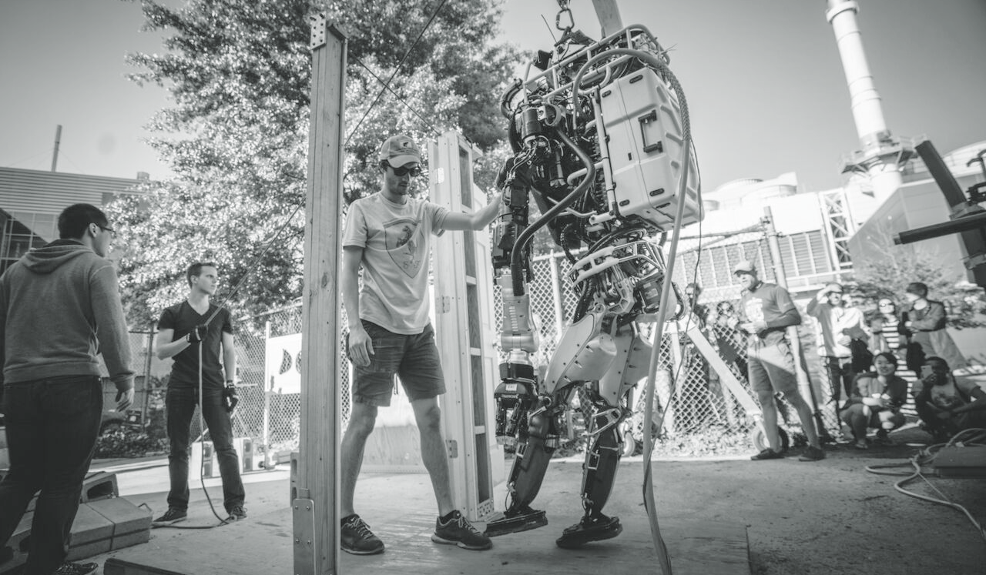
What if?
Notes:
LAURA
We wanted to show you how this all can work in practice, so we’ve illustrated an example of a team who won the $100K competition for a crop-mapping drone, out of the AeroAstro department. [Detail about the case study]
This example assumes that, in a shared editorial format (e.g. meeting or calendar) MIT News, SoE, and DLCs are collaborating to surface stories and potential opportunities for amplification. With MIT News identified as the primary publisher, SoE and AeroAstro then map out their promotion plan, too.

Slide 51
MIT News publishes story
Notes:
LAURA

Slide 52
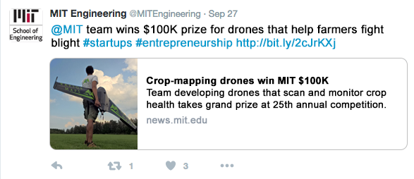
MIT News publishes story
SoE touts MIT News story in SoE homepage hero and tweets a link to the story
Notes:
LAURA

Slide 53
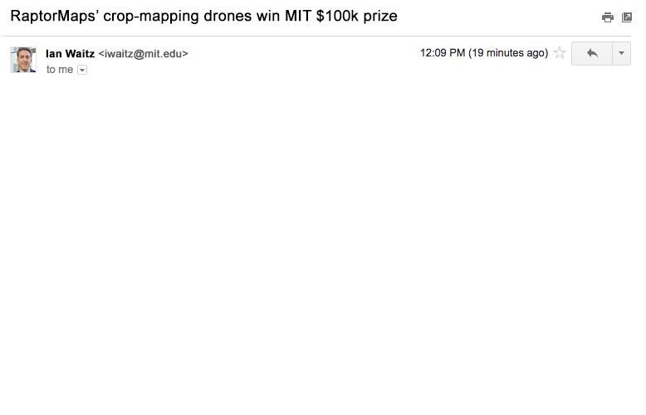
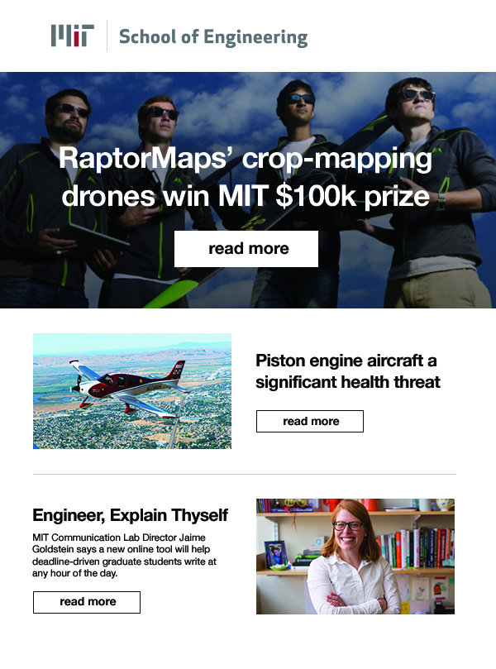
MIT News publishes story
SoE touts MIT News story in SoE homepage hero and tweets a link to the story
SoE sends email to alumni linking to MIT News story
Notes:
LAURA
Drone story is in the hero position; the second tout is customized to the DLC the recipient is affiliated with (if not available, it reverts to a general-interest SoE story)
(Third tout is also a general-interest SoE story.)

Slide 54
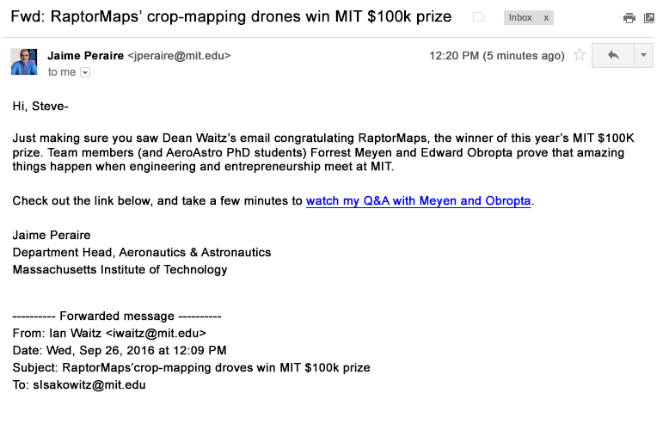
MIT News publishes story
SoE touts MIT News story in SoE homepage hero and tweets a link to the story
SoE sends email to alumni linking to MIT News story
DLC “fake forwards” SoE email to DLC alumni
Notes:
LAURA
A personal note from the Dean to DLC’s list. A low-effort way to endorse/bump up the message, and add a “local angle” (in this case an interview with the Aero-Astro members of the winning team).

Slide 55
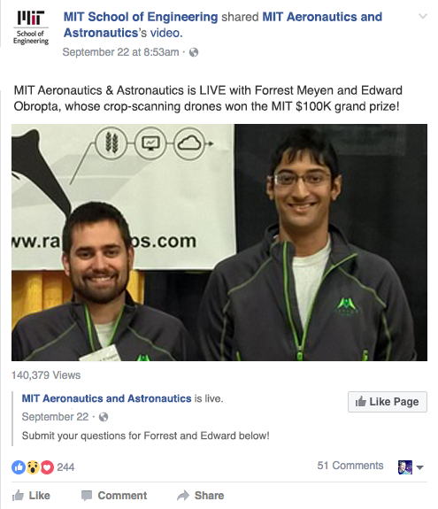
MIT News publishes story
SoE touts MIT News story in SoE homepage hero and tweets a link to the story
SoE sends email to alumni linking to MIT News story
DLC “fake forwards” SoE email to DLC alumni
DLC posts invite to Facebook Live Q&A
Notes:
LAURA
DLC posts an invite to a Facebook Live Q&A on its Facebook page

Slide 56
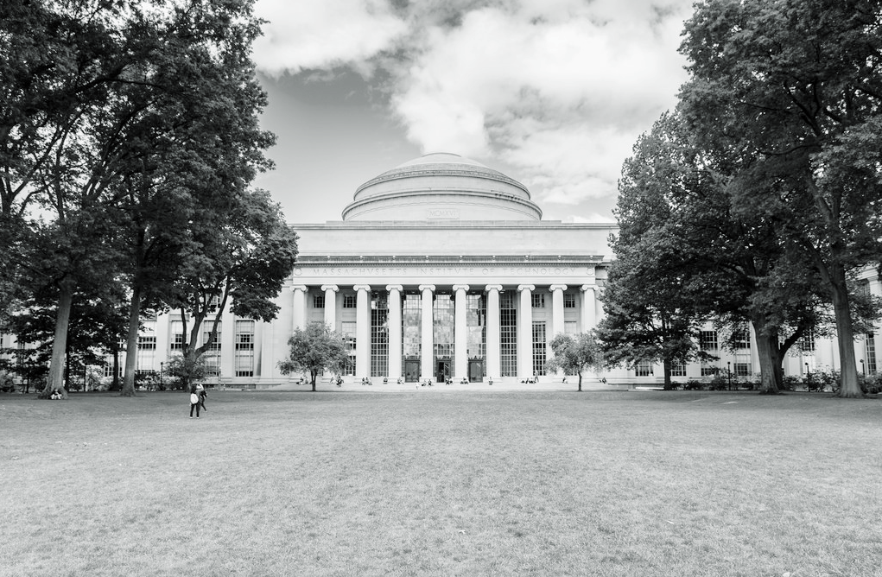
Attract top talent, at all levels
© Blue State Digital | Proprietary and Confidential
Notes:
Who we are / what we do.

